Slide 1
Random Forest

Slide 2
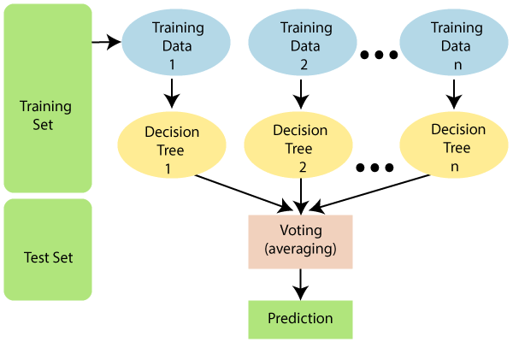
Introduction
What is Random Forest?
"Random Forest is a classifier that contains a number of decision trees on various subsets of the given dataset and takes the average to improve the predictive accuracy of that dataset."
Instead of relying on one decision tree, the random forest takes the prediction from each tree and based on the majority votes of predictions, and it predicts the final output.
The greater number of trees in the forest leads to higher accuracy and prevents the problem of overfitting.
It can be used for both Classification and Regression problems in ML. It is based on the concept of ensemble learning, which is a process of combining multiple classifiers to solve a complex problem and to improve the performance of the model.
Assumptions for Random Forest
Since the random forest combines multiple trees to predict the class of the dataset, it is possible that some decision trees may predict the correct output, while others may not. But together, all the trees predict the correct output. Therefore, below are two assumptions for a better Random forest classifier:
There should be some actual values in the feature variable of the dataset so that the classifier can predict accurate results rather than a guessed result.
The predictions from each tree must have very low correlations.
Why use Random Forest?
Below are some points that explain why we should use the Random Forest algorithm:
<="" li="">It takes less training time as compared to other algorithms.
It predicts output with high accuracy, even for the large dataset it runs efficiently.
It can also maintain accuracy when a large proportion of data is missing.

Slide 3
How does Random Forest algorithm work?
Random Forest works in two-phase first is to create the random forest by combining N decision tree, and second is to make predictions for each tree created in the first phase.
The Working process can be explained in the below steps and diagram:
Step-1: Select random K data points from the training set.
Step-2: Build the decision trees associated with the selected data points (Subsets).
Step-3: Choose the number N for decision trees that you want to build.
Step-4: Repeat Step 1 & 2.
Step-5: For new data points, find the predictions of each decision tree, and assign the new data points to the category that wins the majority votes.
Applications
There are mainly four sectors where Random forest mostly used:
Banking: Banking sector mostly uses this algorithm for the identification of loan risk.
Medicine: With the help of this algorithm, disease trends and risks of the disease can be identified.
Land Use: We can identify the areas of similar land use by this algorithm.
Marketing: Marketing trends can be identified using this algorithm.

Slide 4
Difference between Decision Tree and Random Forest
Decision Trees | Random Forest
They usually suffer from the problem of overfitting if it’s allowed to grow without any control. | Since they are created from subsets of data and the final output is based on average or majority ranking, the problem of overfitting doesn’t happen here.
A single decision tree is comparatively faster in computation. | It is slower.
They use a particular set of rules when a data set with features are taken as input. | Random Forest randomly selects observations, builds a decision tree and then the result is obtained based on majority voting. No formulas are required here.

Slide 5
Important Hyperparameters
Hyperparameters are used in random forests to either enhance the performance and predictive power of models or to make the model faster.
The following hyperparameters are used to enhance the predictive power:
n_estimators: Number of trees built by the algorithm before averaging the products.
max_features: Maximum number of features random forest uses before considering splitting a node.
mini_sample_leaf: Determines the minimum number of leaves required to split an internal node.
The following hyperparameters are used to increase the speed of the model:
n_jobs: Conveys to the engine how many processors are allowed to use. If the value is 1, it can use only one processor, but if the value is -1,, there is no limit.
random_state: Controls randomness of the sample. The model will always produce the same results if it has a definite value of random state and if it has been given the same hyperparameters and the same training data.
oob_score: OOB (Out Of the Bag) is a random forest cross-validation method. In this, one-third of the sample is not used to train the data but to evaluate its performance.

Slide 6
Advantages of Random Forest Algorithm
Can perform both Regression and classification tasks.
Produces good predictions that can be understood easily.
Can handle large data sets efficiently.
Provides a higher level of accuracy in predicting outcomes over the decision algorithm.
Disadvantages of Random Forest Algorithm
While using a Random Forest Algorithm, more resources are required for computation.
It Consumes more time compared to the decision tree algorithm.
Less intuitive when we have an extensive collection of decision trees.
Extremely complex and requires more computational resources.

